Slide 1
Saarthi - an Information Retrieval Project for CS F469
VRITANT CHOPRA - 2021B4A72501P
SURAJ PAL - 2021B2A72755P

Slide 2
Agenda
Project Introduction
Technical Choices
Page Overviews
Retrieval Process
Live Demo
Learnings

Slide 3
Introduction
Efficient and accurate IR systems have become essential for extracting relevant information. One domain where this need is particularly critical but often overlooked is spirituality, where seekers frequently struggle to find trustworthy and relevant resources amidst overwhelming and unstructured content online. Saarthi tries to do just that!
This project presents the design and implementation of an IR system based on the Vector Space Model (VSM), incorporating TF-IDF weighting and cosine similarity for ranking.
To enhance accessibility, the system integrates seamlessly with a web-based frontend, allowing users to input queries through a graphical interface.

Slide 4
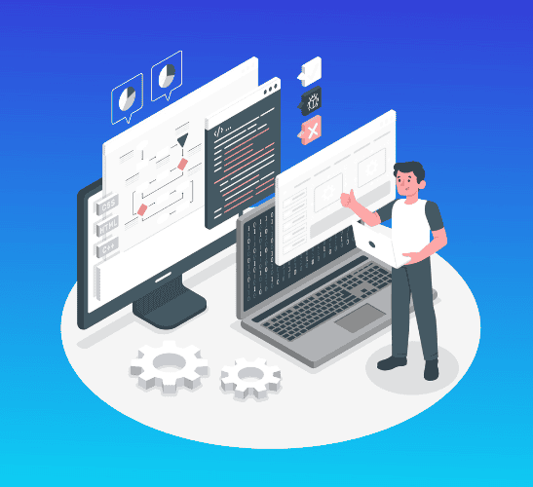
Technical Choices
Frontend : ReactJS, NextJS
Backend : NodeJS, Flask (Python)
Database : postgreSQL, prisma
Styling : Tailwind CSS
Version Control : Git and Github

Slide 5
Web App Pages (Overview)
 | Page Name
1. | Landing / Home Page
2. | Sign In
3. | Log In
4. | Search Page (IR System)

Slide 6
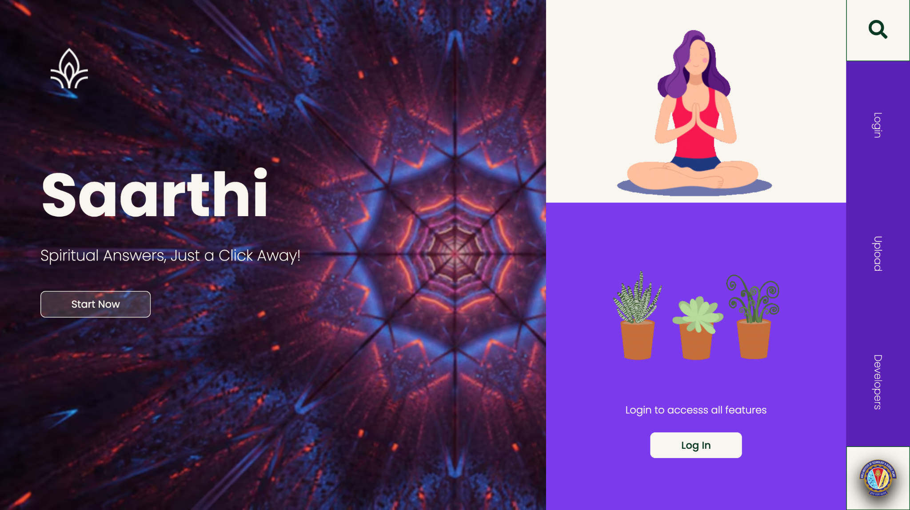
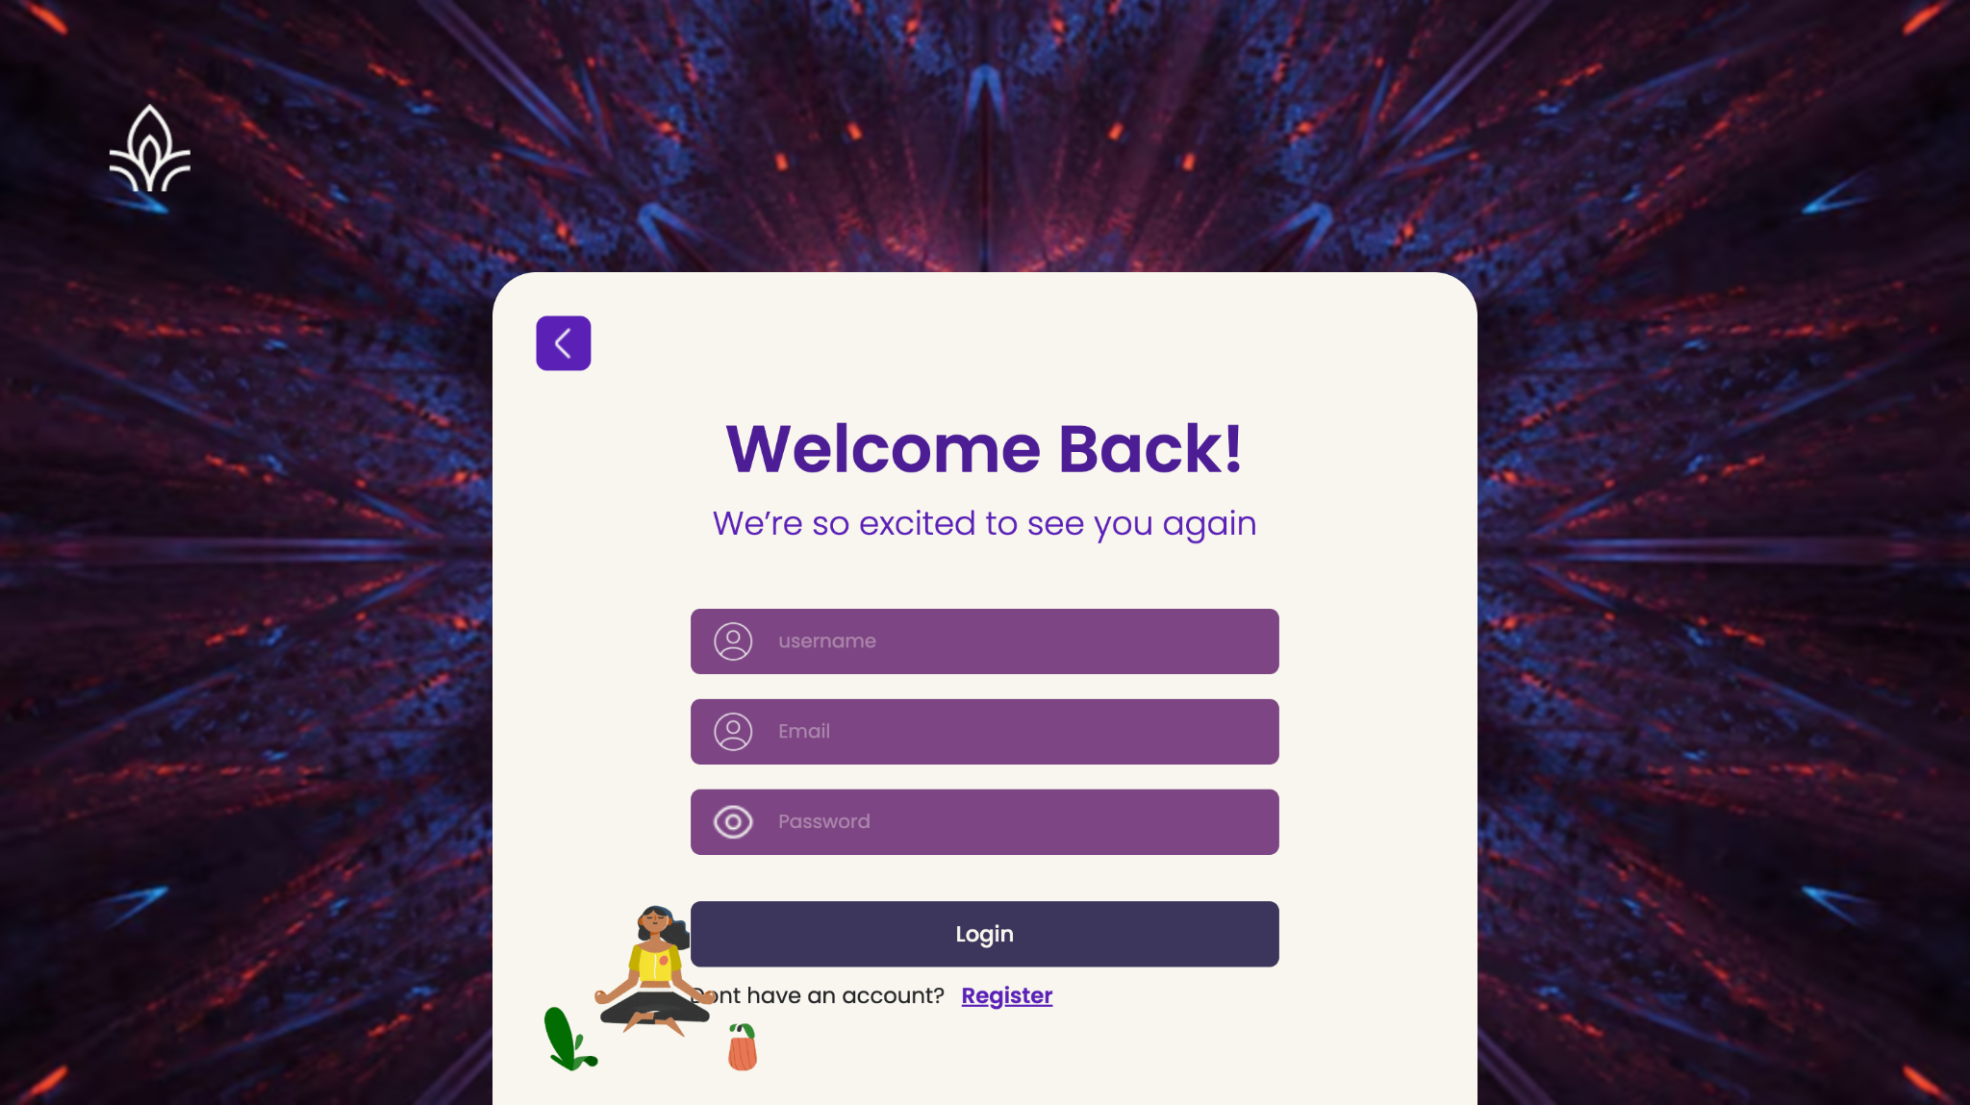
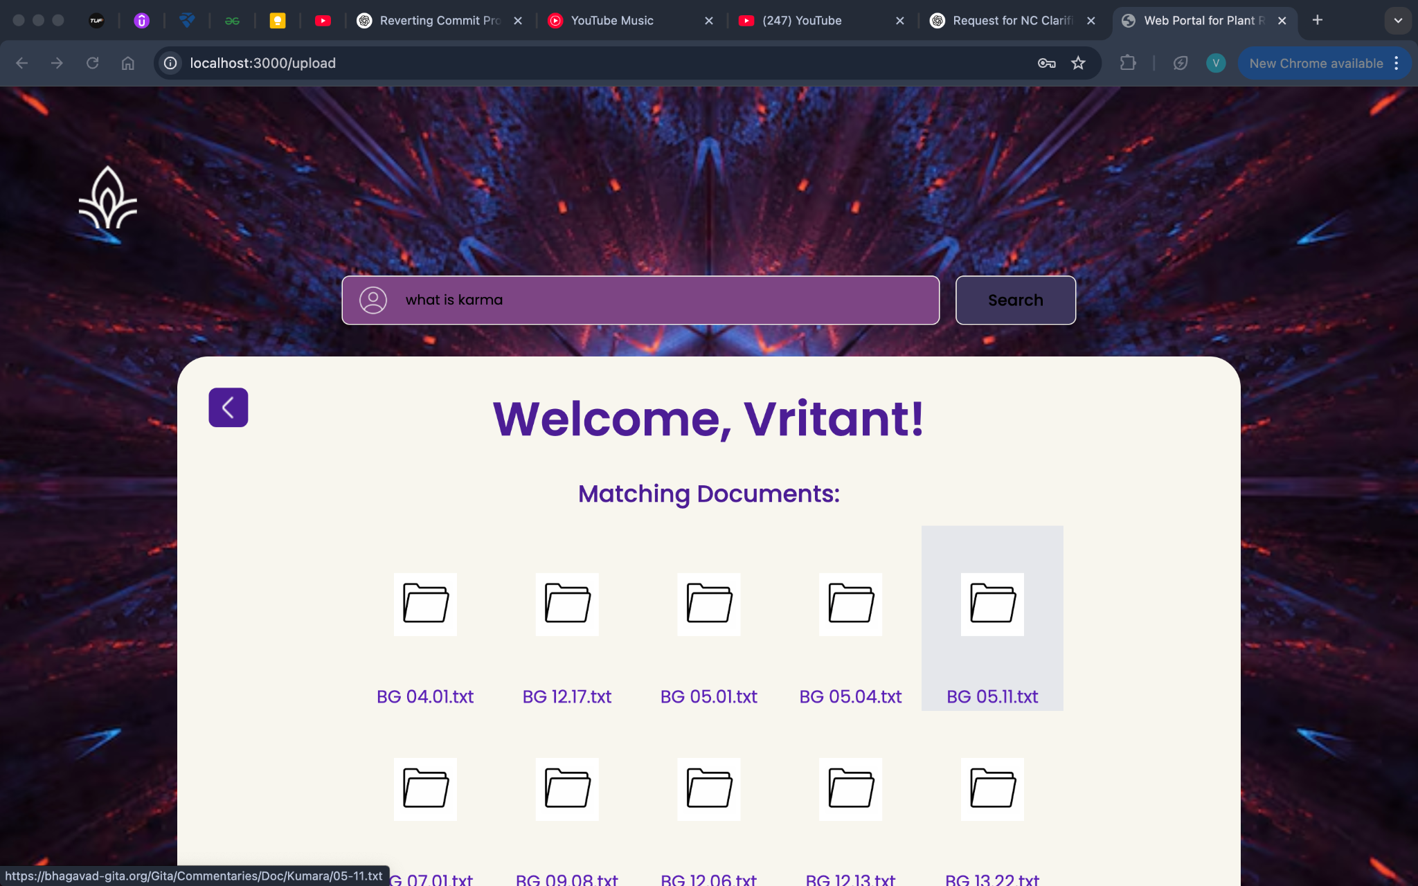
Page Overviews

Slide 7
Home Page
Serving as the primary interface for all visitors, the home page is the starting point of the application.
It includes options for both login and query upload, enabling users to easily navigate and choose their next steps based on their needs.

Slide 8
Login/Sign Up Page
For storing user information and identifying who is uploading data, sign up and login of users is very critical.
We have provided signup facility for first time users. Any first time user will have to sign up or else he will not be recognised by the system.
While logging in, users will have to enter the email address and the password they had previously provided while signing up.
The login information provided will be stored in the ‘userInfo’ table in the DB created.
A hyperlink is provided if any user wants to switch between login and sign up. He can go back to the home page as well at any time.

Slide 9
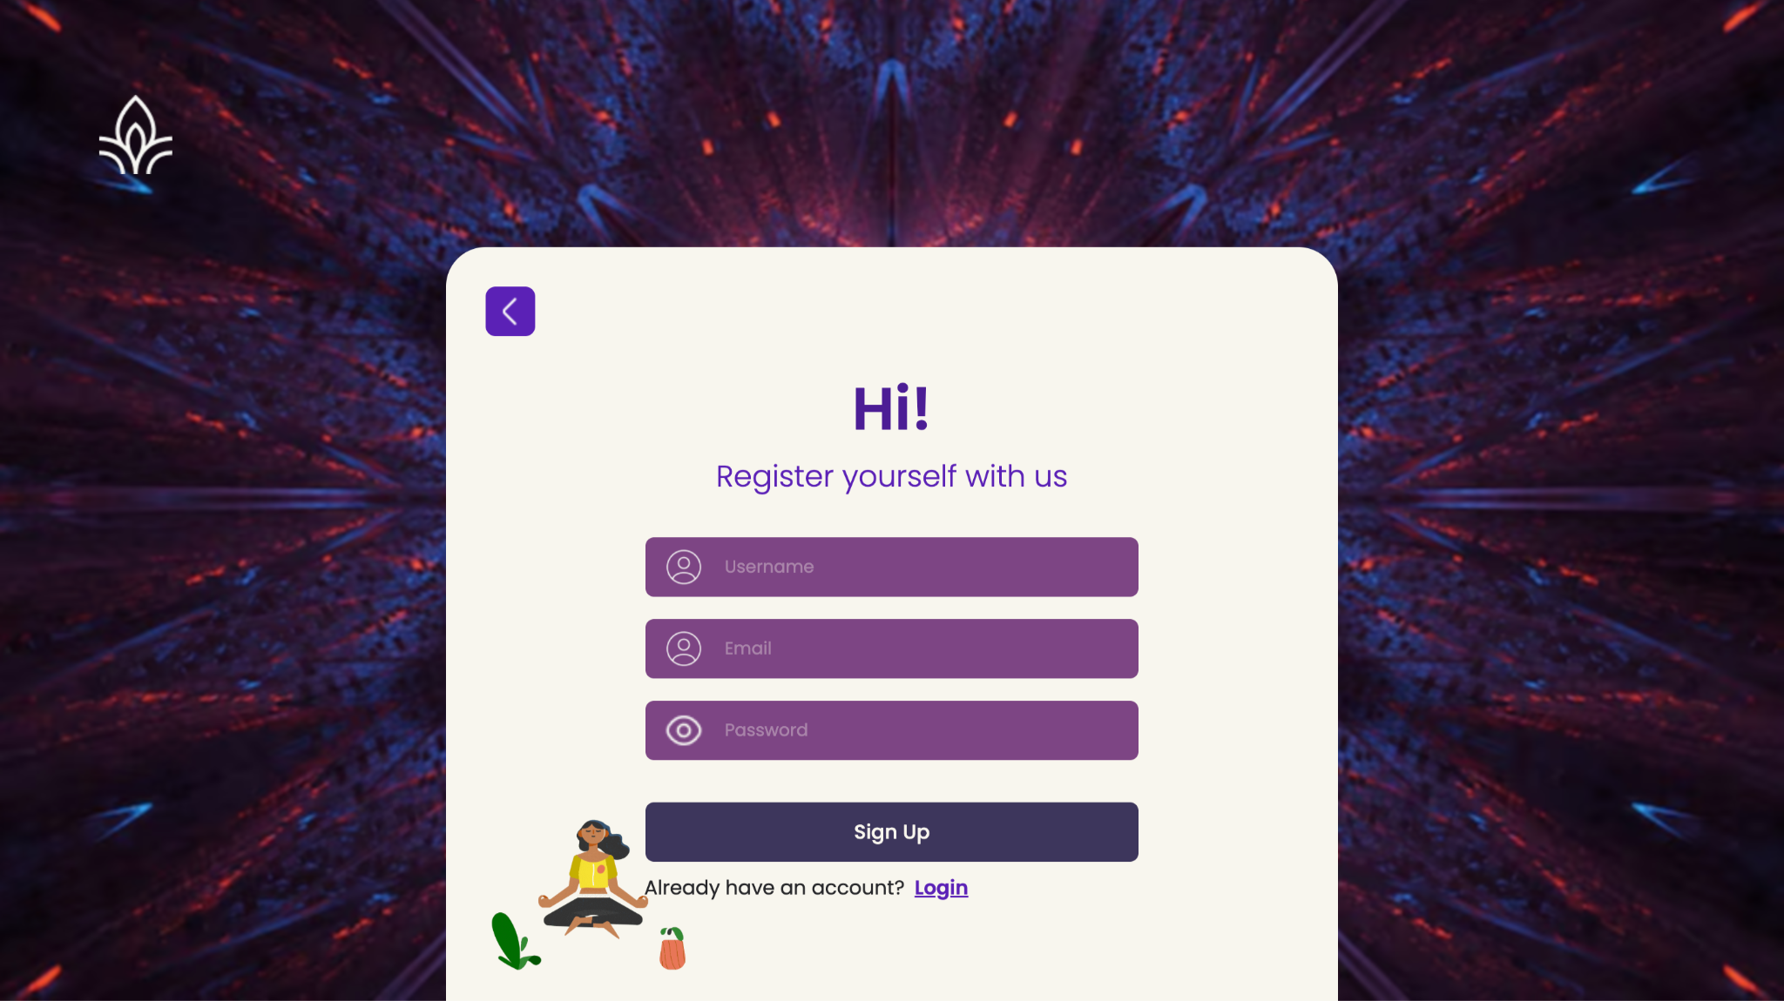
Login/Sign Up Page
Sign Up Page
Login Page

Slide 10
Query Upload Page
The Upload page is where all the IR machinery is deployed. The user will have to enter a ‘Search Query’ to retrieve relevant documents from the corpus.
On clicking the search button, the IR System gets activated through Flask.
The core of the Information Retrieval system relies on the vector space model, wherein both documents and user queries are represented as vectors in a high-dimensional term space. The TF-IDF method is used to assign appropriate weights to terms.
Cosine similarity is then employed yielding a ranked list of results.

Slide 11
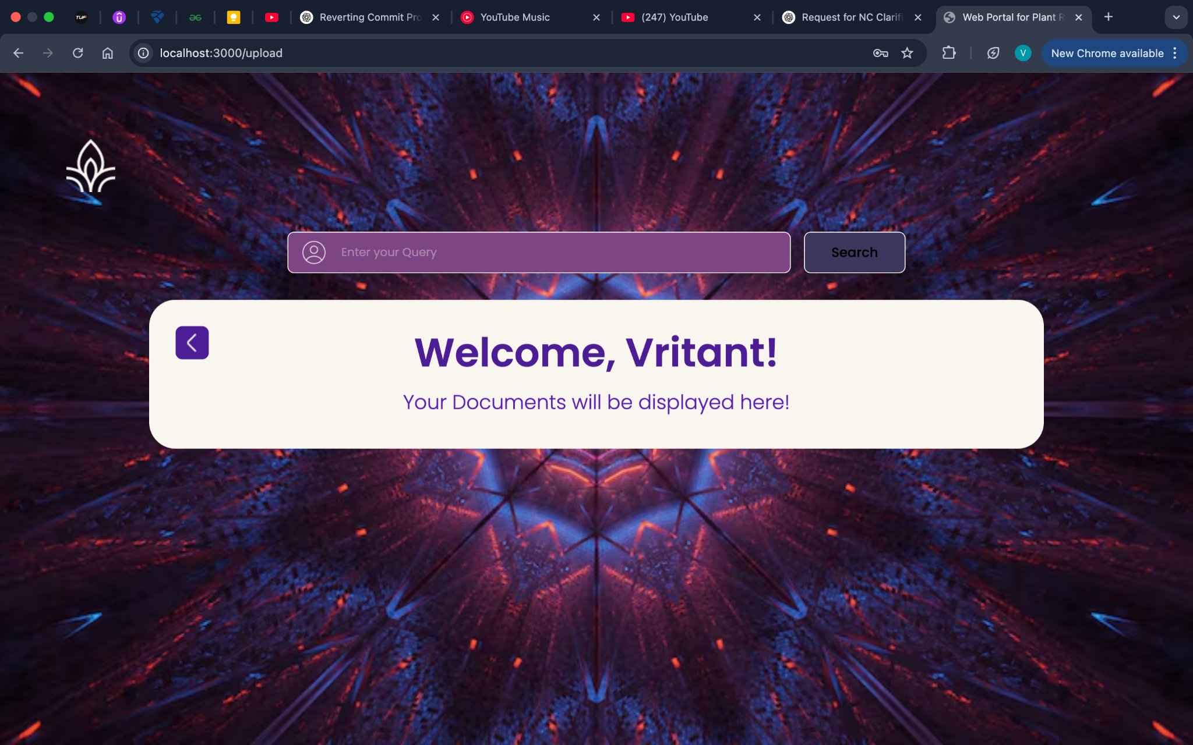
Query Upload Page

Slide 12
Retrieval Process
A. Preprocessing Pipeline :
The preprocessing block ensures that only informative, meaningful terms contribute to the TF-IDF vectors. The steps involved are:
1) Tokenization: Raw text is split into individual words using NLTK’s word tokenize().
2) Stopword Removal: Standard English stopwords are removed using the NLTK corpus, with custom exclusions for terms like to, in, and where, which hold semantic importance in user queries.
3) Punctuation and Symbol Filtering: Non-alphabetic tokens, punctuation marks, and numerals are discarded.

Slide 13
Retrieval Process
B. TF-IDF Matrix Construction :
After preprocessing, a term-document matrix is constructed. Each document is represented as a vector of TF-IDF scores. The matrix is stored in a Pandas DataFrame, where rows correspond to terms and columns to document IDs.
The system normalizes each vector using its L2 norm.
This facilitates cosine similarity computation with the query vector, ensuring scale-invariant comparison.
C. Query Handling and Ranking :
When a query is received, it undergoes the same preprocessing steps as the documents. The resulting query vector is then compared with each document vector using cosine
similarity. Documents are ranked in descending order of similarity.

Slide 14
Live Demo

Slide 15
Learnings
Document and query preprocessing (Tokenization, stopword removal, normalization)
Implemented Information Retrieval system based on tf-idf scores and cosine similarity.
Built a fully functional web application using React.js and Next.js.
Learnt efficient database management and handling transactions via Prisma.

Slide 16
THANK YOU

